Slide 1
Keras stock Predictor
Eric Hagee, Sanket Mishra, Meenakshi Kavaseri, Brian Klovert, and Shagufta Zareen

Slide 2
Introduction
Stock Market Prediction is an interesting, but difficult machine learning problem
Unlike many problems, this is a time series, necessitating somewhat different methodology

Slide 3
Data and Methods
As a good beginning data set, we retrieved a data set of daily dow jones stock prices from Kaggle with one stock (wmt) chosen at random to compare between various machine learning models
This presentation discusses the use of a long short-term memory (LSTM) neural network
Image: A diagram of an LSTM cell, designed to “remember” details about previous input, which demonstrates potential for time series data.
Retrieved from: https://commons.wikimedia.org/wiki/File:The_LSTM_cell.png

Slide 4
Data preprocessing
Load data in pandas, convert to numpy arrays
Create input (a set length of days with open/high/low/close prices and output (close date at a future point)
Normalize data using training set with scikit learn
Build neural network using keras

Slide 5
First results
Results with (256, 256, 32) neurons in each layer and 30 days used to predict 5 days in future.

Slide 6
Importance of time period
Left: 180 days input, 80 days future point Right: 20 days input, 1 day future point

Slide 7
Hyperparameter training
Hyperparameters were trained using 30 days of input and 5 days future point
One hyperparameter trained at time, select best option using rmse score of training set
Final Parameters: set of (128, 128, 16) neurons in each layer, 100 training epochs, dropout of 0.3, 75/25 train/test split, 0.1 validation set slice, and batch size of 32

Slide 8
Some improved performance…
Left: 30 days input, 5 days future point Right: 5 days input, 1 day future point
Our tuning seems to improve the capability and get the magnitude right

Slide 9
But, time window still important
30 days input, 30 days future point gets some magnitude right, but clearly worse than previous slide
Longer time windows are terrible
Clearly, shorter times work better, but this is likely due to the fact that the stock market changes much less on a shorter time scale

Slide 10
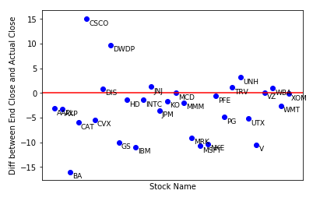
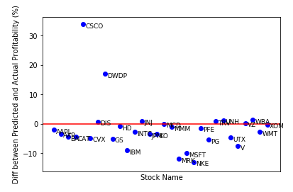
Application to other stocks in dow jones industrial average

Slide 11
Current conclusions
The stock market is very hard to predict, as general knowledge indicates
Lstm neural network shows some usage
Time windows are important (stocks change less in short time windows, and more recent data is likely more indicative), could use further study
Hyperparameter tuning improves performance, though more might improve results
Results are variable, margins are slim to predict actual profit or not
However, model trained on one stock seems to be applicable to other stocks

